Slide 1
Assigning classes to the clusters
After creating pure clusters belonging exclusively to one object, we need to classify these clusters based on the object to which they belong.
The clusters are segregated in roughly three equal classes based on their zeroth order moment. This segregation is used as an initialization for the classes of projection.
Class | Total number of Clusters | Correctly classified | Incorrectly classified | Percentage Correct
1 | 118 | 94 | 24 | 79.66101695
2 | 90 | 65 | 25 | 72.22222222
3 | 92 | 51 | 41 | 55.43478261

Slide 2
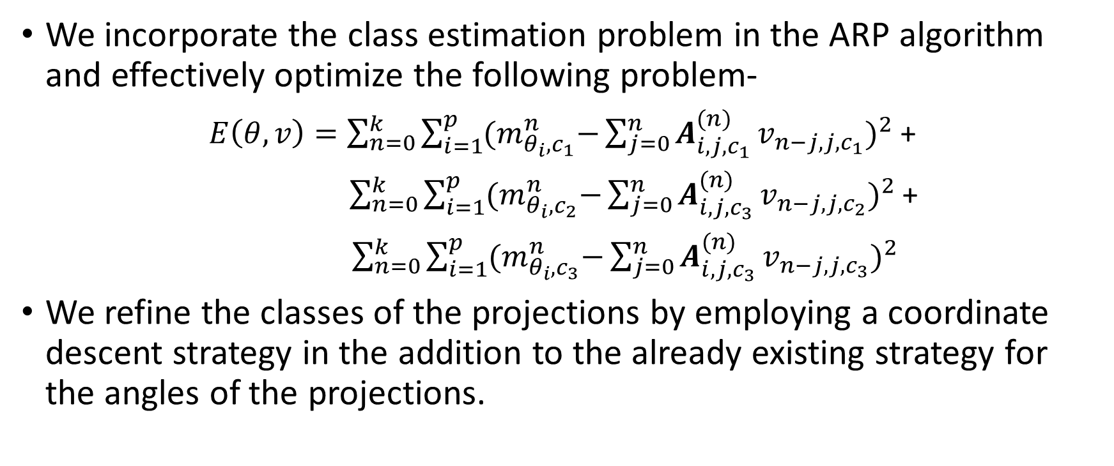
Refining class estimates
We incorporate the class estimation problem in the ARP algorithm and effectively optimize the following problem-
$E\left(θ, v\right)=\sum_{n=0}^{k}{\sum_{i=1}^{p}{{(m}_{θ_{i},c_{1}}^{n}−{{\sum_{j=0}^{n}{A_{i,j, c_{1}}^{(n)}}v}_{n−j, j,c_{1}})}^{2}}}$ +
$\sum_{n=0}^{k}{\sum_{i=1}^{p}{{(m}_{θ_{i},c_{2}}^{n}−{{\sum_{j=0}^{n}{A_{i,j,c_{3}}^{(n)}}v}_{n−j, j,c_{2}})}^{2}}}$+
$\sum_{n=0}^{k}{\sum_{i=1}^{p}{{(m}_{θ_{i},c_{3}}^{n}−{{\sum_{j=0}^{n}{A_{i,j,c_{3}}^{(n)}}v}_{n−j, j,c_{3}})}^{2}}}$
We refine the classes of the projections by employing a coordinate descent strategy in the addition to the already existing strategy for the angles of the projections.

Slide 3
Does not refine the classes…
The optimization converges to the wrong solution.
It predicts the wrong class for each projection may be because of the noise in each of the projections as well as wrong assignment of classes initially.
Tried out various other things to improve the estimate such as, changing the optimization problem to min(three class errors) or only including error of the classes that are currently being changed.
Also, tried to change the clustering method, or including a bit of randomness in the initial estimate and performing a multi-start approach.

Slide 4
Possible explanation and remedy
Maybe the refinement is too drastic at the start. We are assigning a class to a projection with complete confidence with affects all future predictions.
So, one possible solution is utilize a probability based approach, where instead of assigning a class to each projection we assign a probability of a projection belonging to a particular class.
This allows the algorithm to recover from a wrong estimate in later iterations.
Include a probability based approach in HLCC-optimization problem.

